Slide 1


Green University of Bangladesh
Course Title : Data Communication Lab
Course Title:CSE-308
Lab Projetc Name:Realtime Chat Application
Presented To-
Amena Zahan
Lecturer,
Department of CSE
Green University of Bangladesh

Slide 2
Index
Introduction
Advantages of Parallel Transmission?
Disadvantages of Parallel Transmission?
serial vs parallel transmission

Slide 3

Realtime chat Application
Real-time chat uses Web-based apps, which permit communication that is usually addressed directly but is anonymous among users in a multi-user environment.

Slide 4
Objective
This is one of the top projects for beginners. It provides client application which runs on the users’ desktop and server application which runs on any machine on the network. To start chatting our client should get connected to a server where they can do group and private chatting.

Slide 5
Software requirements of the project
1.VS code
2.Chorom web browser
3.Windows powershell or CMD
4.Insomaia

Slide 6
Implementation Languages used to develop the project
1.HTML
2.CSS
3.JavaScript
5.Firebase
6.React

Slide 7
Database
1.Firebase
2.MongoDB

Slide 8
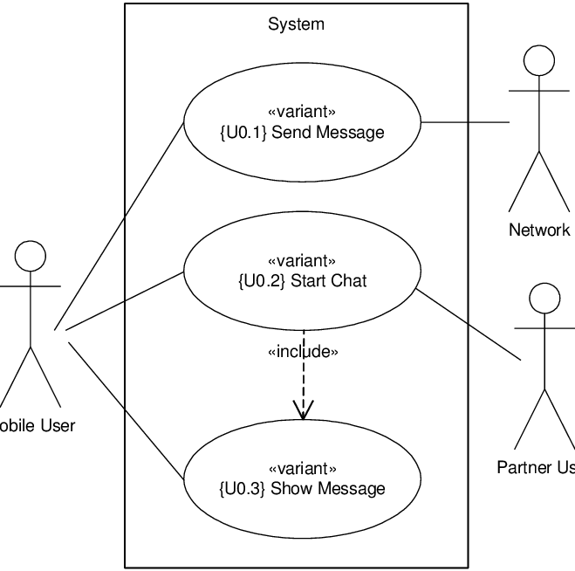
Use case diagram

Slide 9
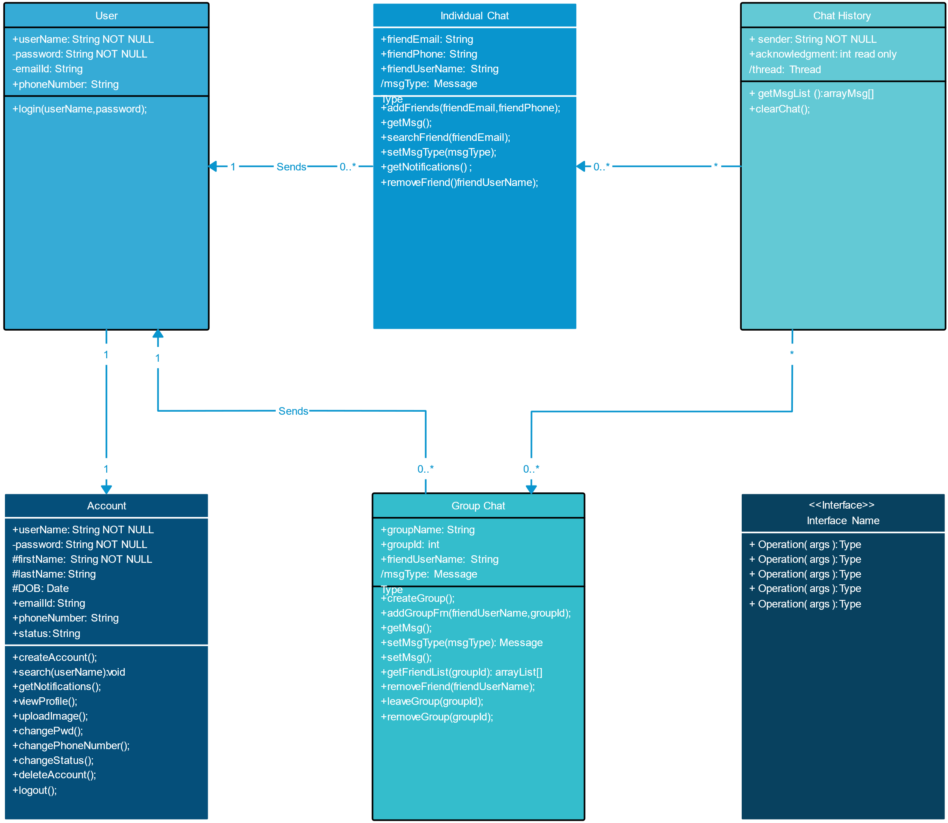
Class diagram

Slide 10
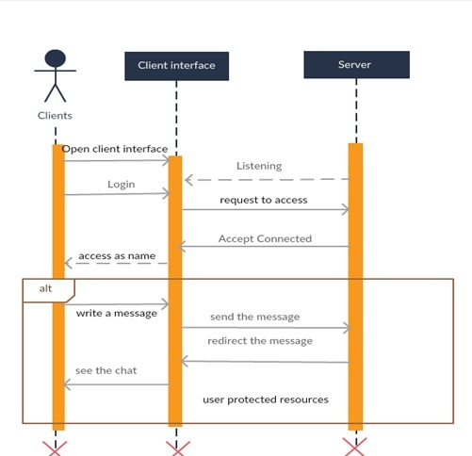
Sequence Diagram

Slide 11
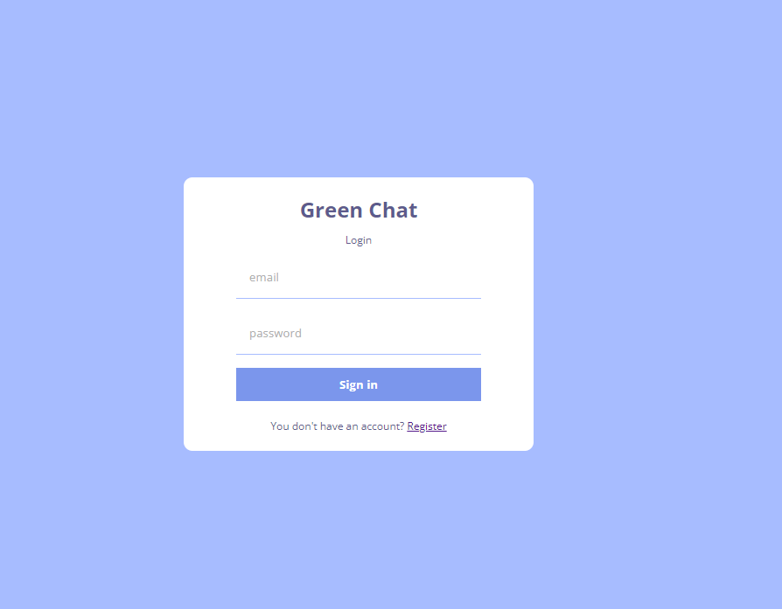
Sample Screenshot

Slide 12
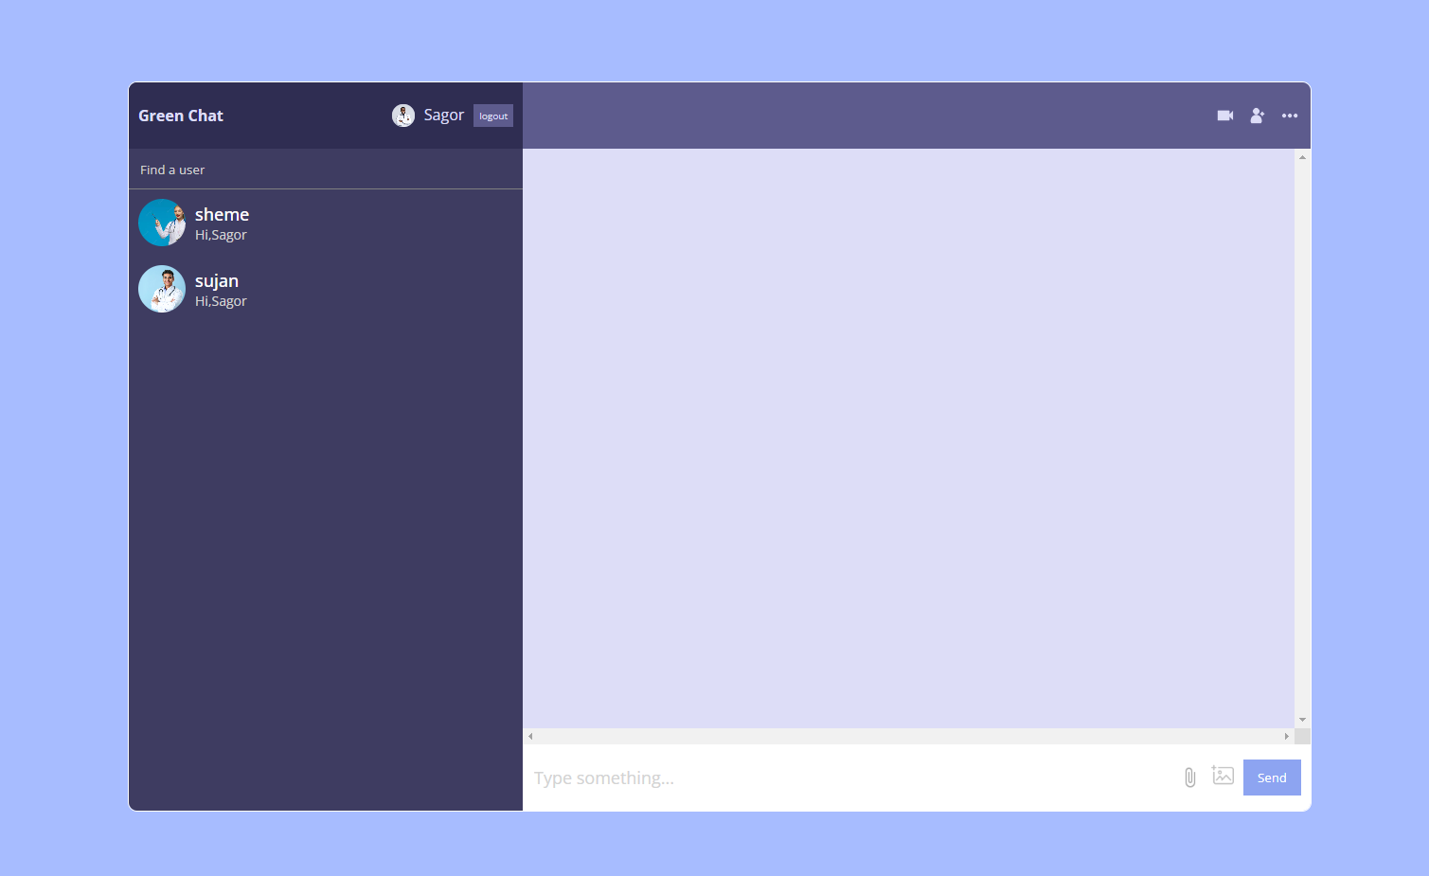
Sample Screenshot

Slide 13
Sample Screenshot

Slide 14
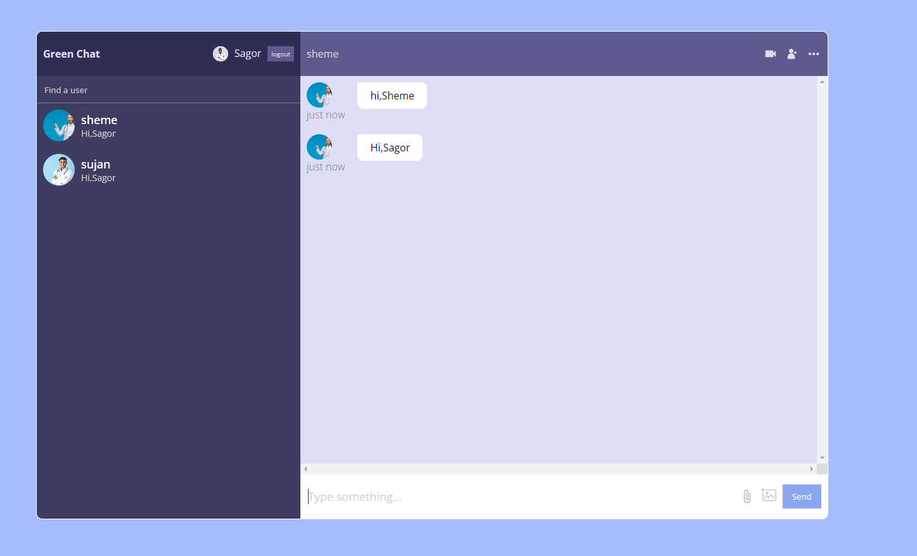
Sample Screenshot

Slide 15
Advantage
Online Chat Support can Boost Conversion Rates and make your Visitors your most Loyal Customers
Deliver Real-time Responses
Provide Faster Support and Increase Real-time Engagement
Saves your Time

Slide 16


